Slide 1




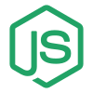
MERN
Combination of 4 techs, Mongo DB, Express, React, Node.

Slide 2

What is MERN Stack
Stands for MongoDB, Express, React, Node.
A popular javascript based technology stack.
Used for building modern web applications
Together they provide a full-stack development solution.

Slide 3

MONGO DB
MongoDB is a database where we store information (like a big digital notebook).
Instead of tables like in Excel, it saves data in JSON-like documents.
It is very fast and can handle a lot of information easily.
Many modern apps use MongoDB to store user data, messages, products, etc.

Slide 4
EXPRESS JS
Express.js helps us build the “back side” of websites.
It works with Node.js to handle requests and responses.
It helps create APIs that connect the frontend (React) with the database (MongoDB).

Slide 5

REACT JS
React.js is used to build the “front side” of websites (what users see).
It helps make web pages look nice and interactive.
Instead of reloading the whole page, React updates only the parts that change.
Single Page application.
Think of it as Lego blocks for building a website’s design.

Slide 6
NODE JS
Node.js lets us run JavaScript on the server (not just in the browser).
It helps build the “engine” that powers the backend of websites.
It is fast and can handle many users at the same time.
Think of it as the kitchen where all the cooking (logic) happens.

Slide 7
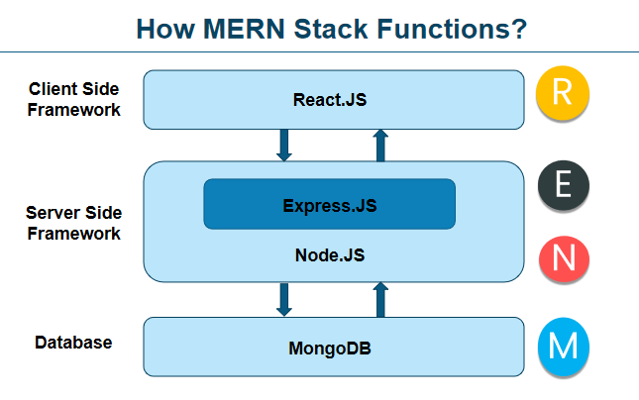
Architecture

Slide 8
Why MERN Stack
Fast Development – Ready-to-use tools and libraries save time.
Scalable & Flexible – Can handle small projects to large apps easily.
Reusable Components – React makes UI building quicker and cleaner.
Open Source – All technologies (MongoDB, Express, React, Node) are free to use.
Huge Community – Lots of tutorials, help, and support online.
Great Job Demand – Many companies hire MERN developers.

Slide 9



LET’S START OUR MERN STACK JOURNEY

